Slide 1
Count My Fish App
Presented by: Rebecca Rickard

Slide 2
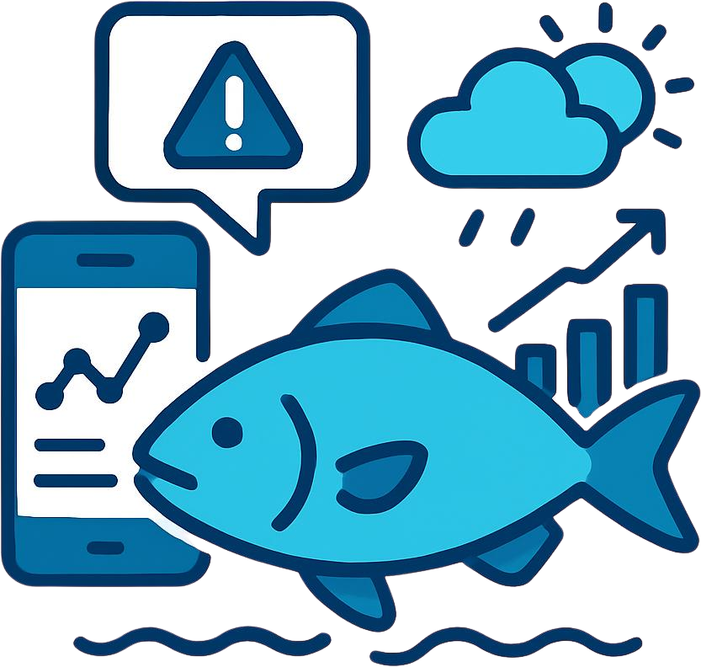
The Problem
Current Challenges:
Limited real-time fishing data
Manual/delayed reporting
Low angler engagement in data collection
Hard to predict fishing conditions

Slide 3
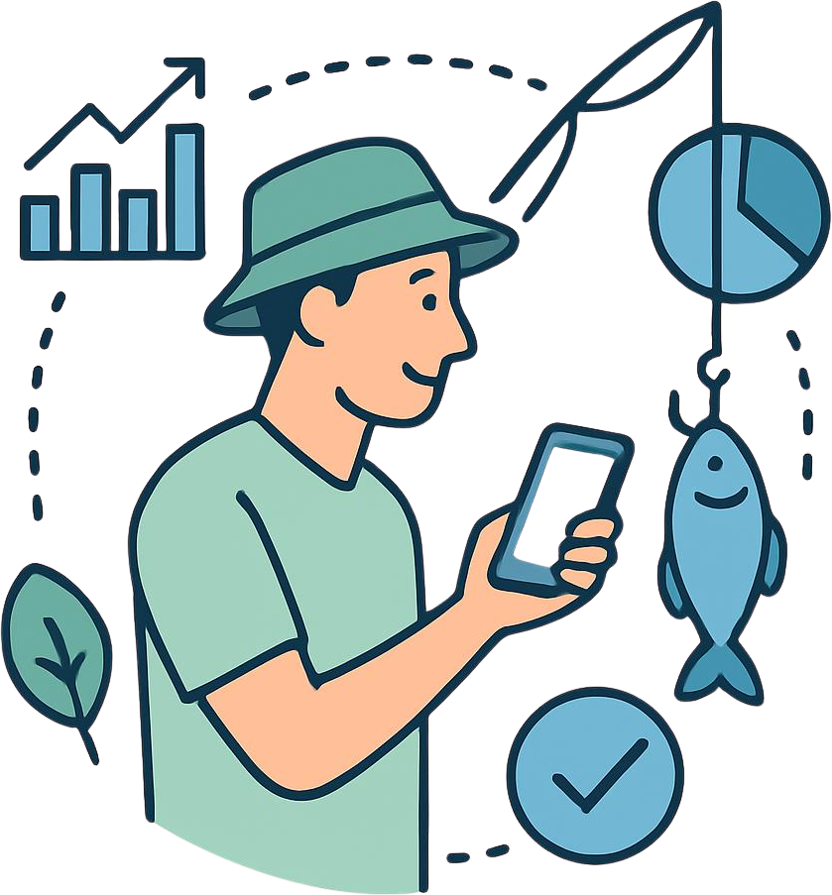
The Opportunity
What if anglers became data collectors?
Real-time catch data
Environmental and behavioral insights
Better decision making for anglers and fisheries

Slide 4
The Solution
Introducing: Count My Fish App
Streamlit-based interactive app
Tracks catches, conditions, and locations
Provides fishing success predictions
Engages users through challenges and leaderboards

Slide 5
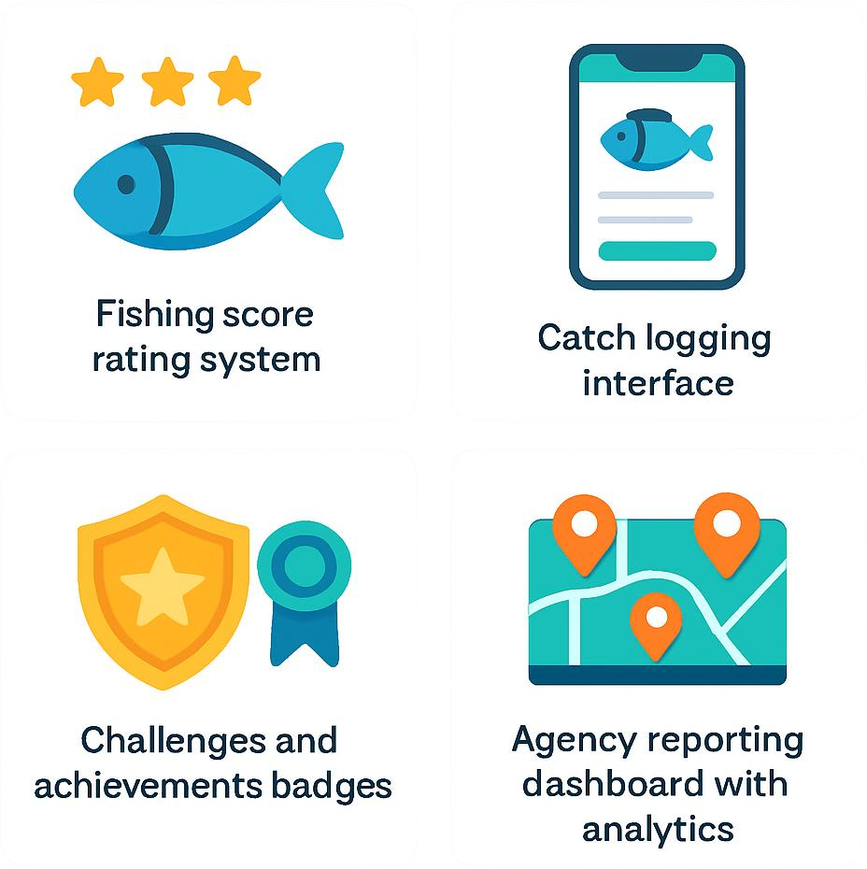
Key Features
Fishing score
Catch logging
Interactive map
Challenges and achievements
Agency reporting dashboard

Slide 6
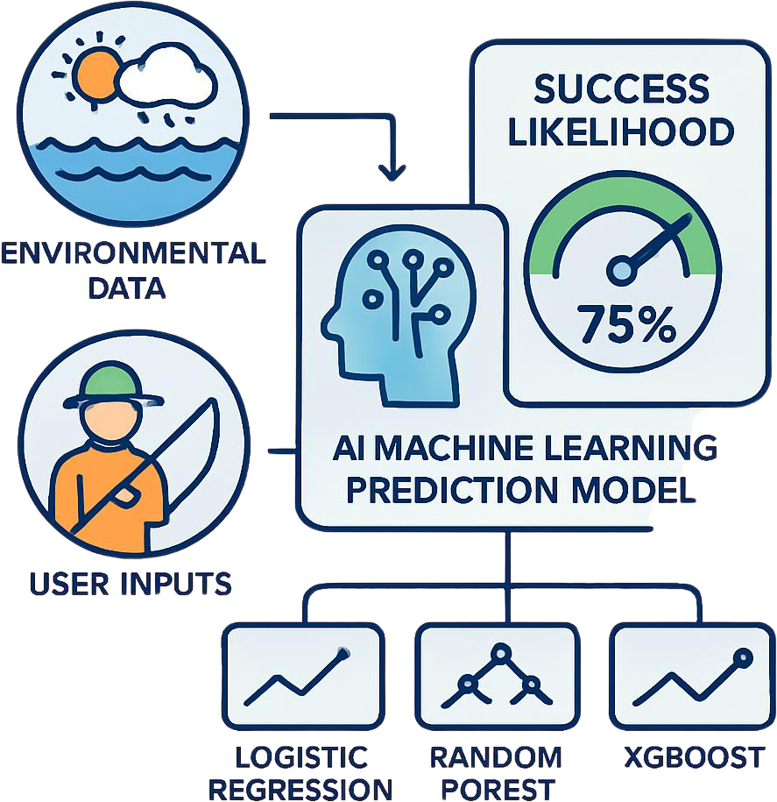
Fishing Score
Uses environmental and user inputs
Predicts likelihood of success
Built with:
Logistic Regression/Random Forest/ XGBoost

Slide 7
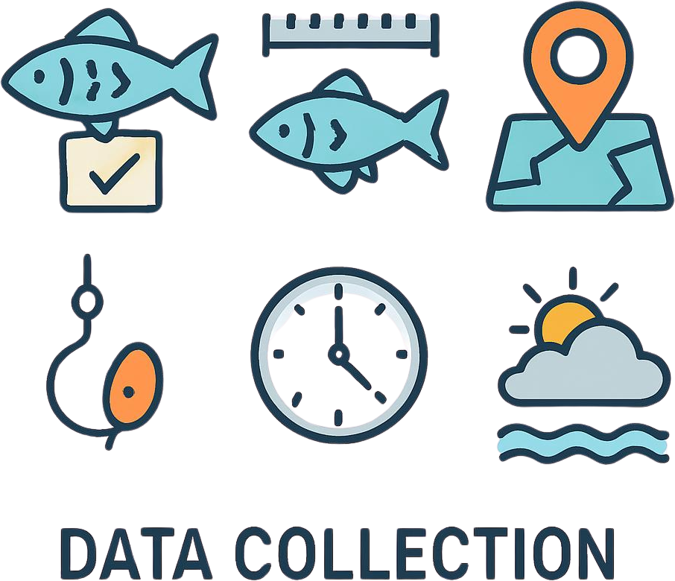
Data Collected
Species
Fish length
Location (GPS or user input)
Bait and technique
Time of day
Weather and tide conditions

Slide 8
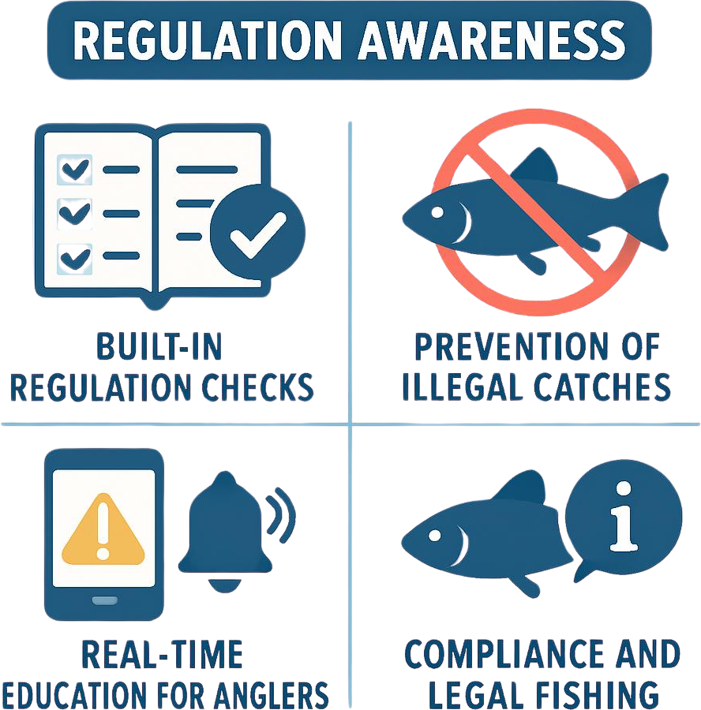

Slide 9
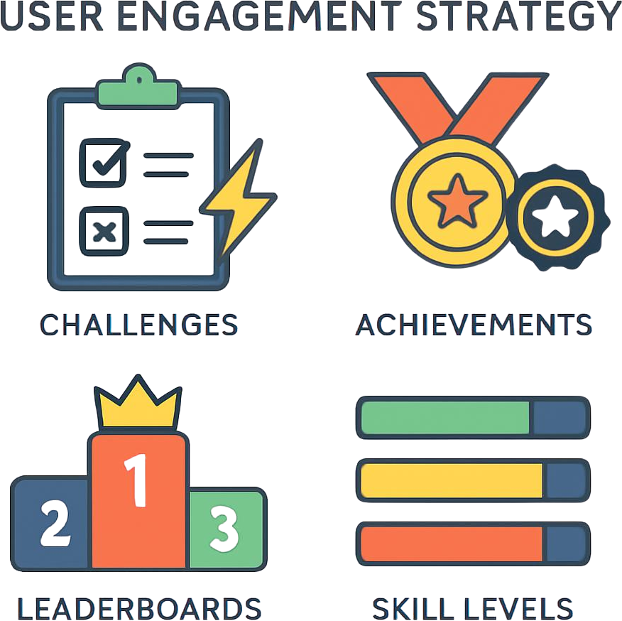
User Engagement Strategy

Slide 10
Agency Value
How this helps NC Division of Marine Fisheries:
Real-time catch data
Better stock monitoring
Behavioral insights (bait, technique, timing)
Regional fishing patterns
Predictive analytics potential

Slide 11
Limitations
SQLite (prototype only)
Limited dataset currently
Requires user adoption

Slide 12
Future Improvements
Transition to PostgreSQL/cloud database
Integration with official Division of Marine Fisheries data
Automated regulation updates
Mobile app version and advanced app re-platforming for a production-grade UI
Enhanced and expanded predictive modeling
Expanded species coverage for broader monitoring
Including tracking and monitoring invasive species
Agency Harvest Report private only to NC Division of Marine Fisheries and other state agencies
Shown in app only for demonstrative purposes

Slide 13
Live Demo
Count My Fish App

Slide 14
Conclusion
Count My Fish transforms anglers into a distributed data network, supporting smarter fisheries management.
Real-time catch data
Better stock monitoring
Behavioral insights (bait, technique, timing)
Regional fishing patterns
Predictive analytics potential

